Slide 1
PC Prices Regression
By: Yee Hang

Slide 2

Objectives
1) - to develop a regression model that predicts pc prices
- There are many shops that might scam people of pc prices as the price of pc is not easy to understand
- Hence, this model hopes to predict the price of a pc based on its specs so that interested buyers so that they know what price range to search for according to the specs that they use
- This model must make as little error as possible as it might cause buyers to make wrong decision

Slide 3
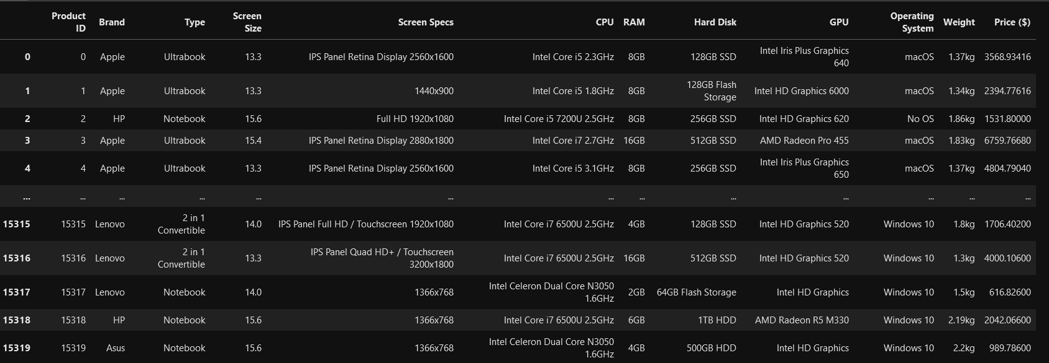
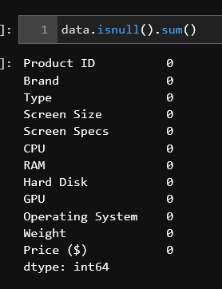
Dataset Info
There are 15319 records and 11 features and the target variable (PC Price in $)
2) There are no null value

Slide 4
Dataset Info
There are 15319 records and 11 features and the target variable (PC Price in $)
2) There are no null values
Data Cleaning
1) Based on the data shown:
Need to clean CPU info (extract the brand and model)
Remove the 'GB' from the RAM
Remove the KG from the Weight
Need to custom one hot encode the hard drive info into columns SSD , HDD , Flash Drive , Hybrid as each type of Hard Drive have different cost for the same amount of storage
Extract the width and height from screen size (larger screens should be more expensive)

Slide 5
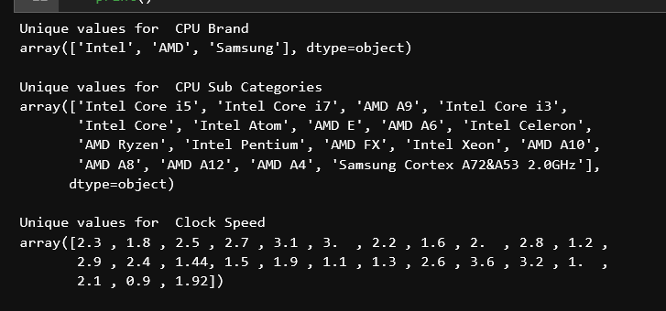
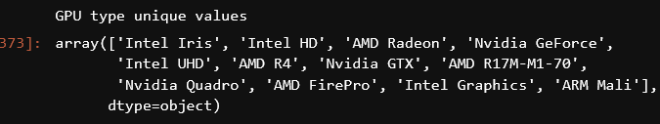
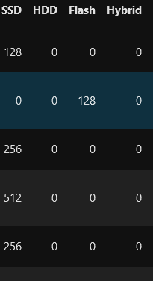
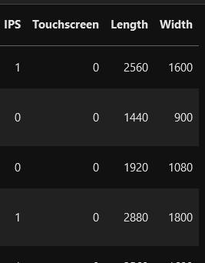
Cleaning
CPU Specs
CPU Brand,
CPU Series such as i3, i5, i7
Obtain cpu clock speed in GHZ
CPU Specs
- Whether the screen has IPS/Touchscreen
Screen width and length
HardDisk Specs
Data is reorganized into column as shown on the right

Slide 6
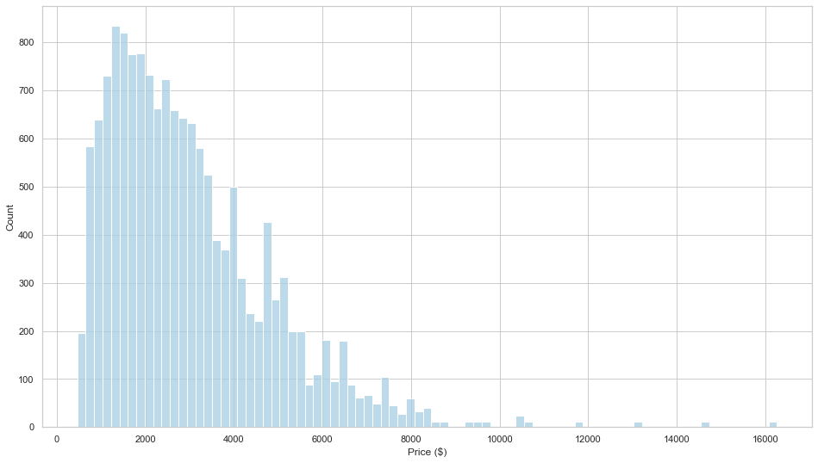
Target Variable analysis
Price follows a very positively skewed distribution
Most computers have prices less than $4000
outliers like $16000 computers and other computers more than $10000 exist
The sklearn.compose.TransformedTargetRegressor can be used to log tranform the column in order for the predictions to be more accurate

Slide 7
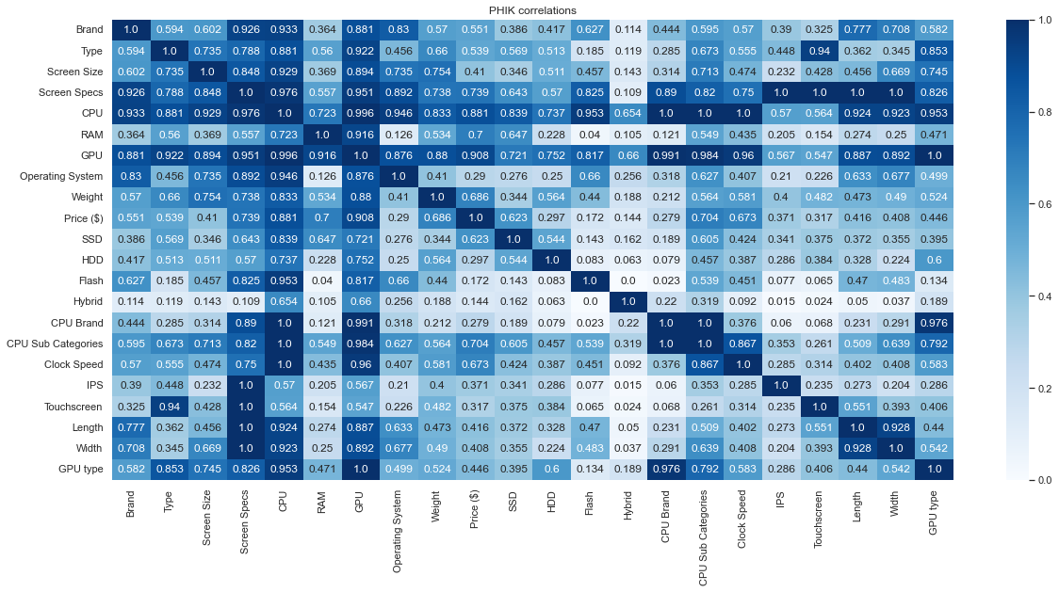
EDA
- There are a lot of redundant features here as a lot of the featueres are highly correlated with each other. For e.g between CPU and GPU
- Manually removing the features might affect the performance of model
- Consider to use RFE or PCA to remove the highly correlated features during modelling
Phik Correlations

Slide 8
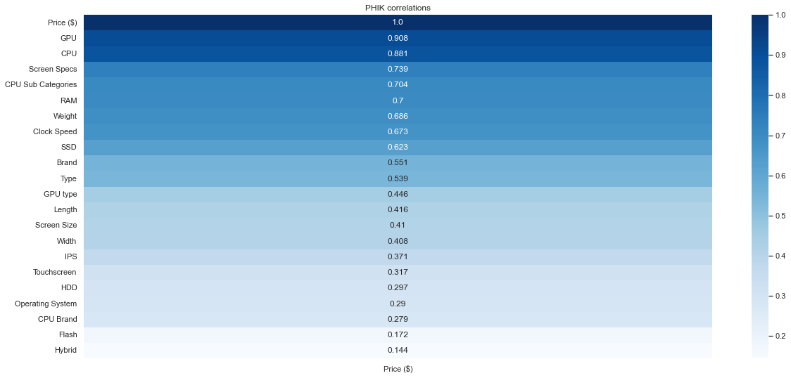
EDA
Phik Correlations with Price sorted
- Strongest correlation is between Price and CPU and GPU at 0.881 and 0.908 respectively
- Generally, hardware specs that affect the pc speed influences the price more (Such as GPU CPU , RAM , and clock speed )
- None of the features have no correlation between itself and price
- Lowest Correlation is Hybrid with 0.144, this is due to only a few computers have Hybrid Drives. This feature with the HDD, Flash , HDD and SSD help to predict the price in the model. Hence should not be dropped

Slide 9
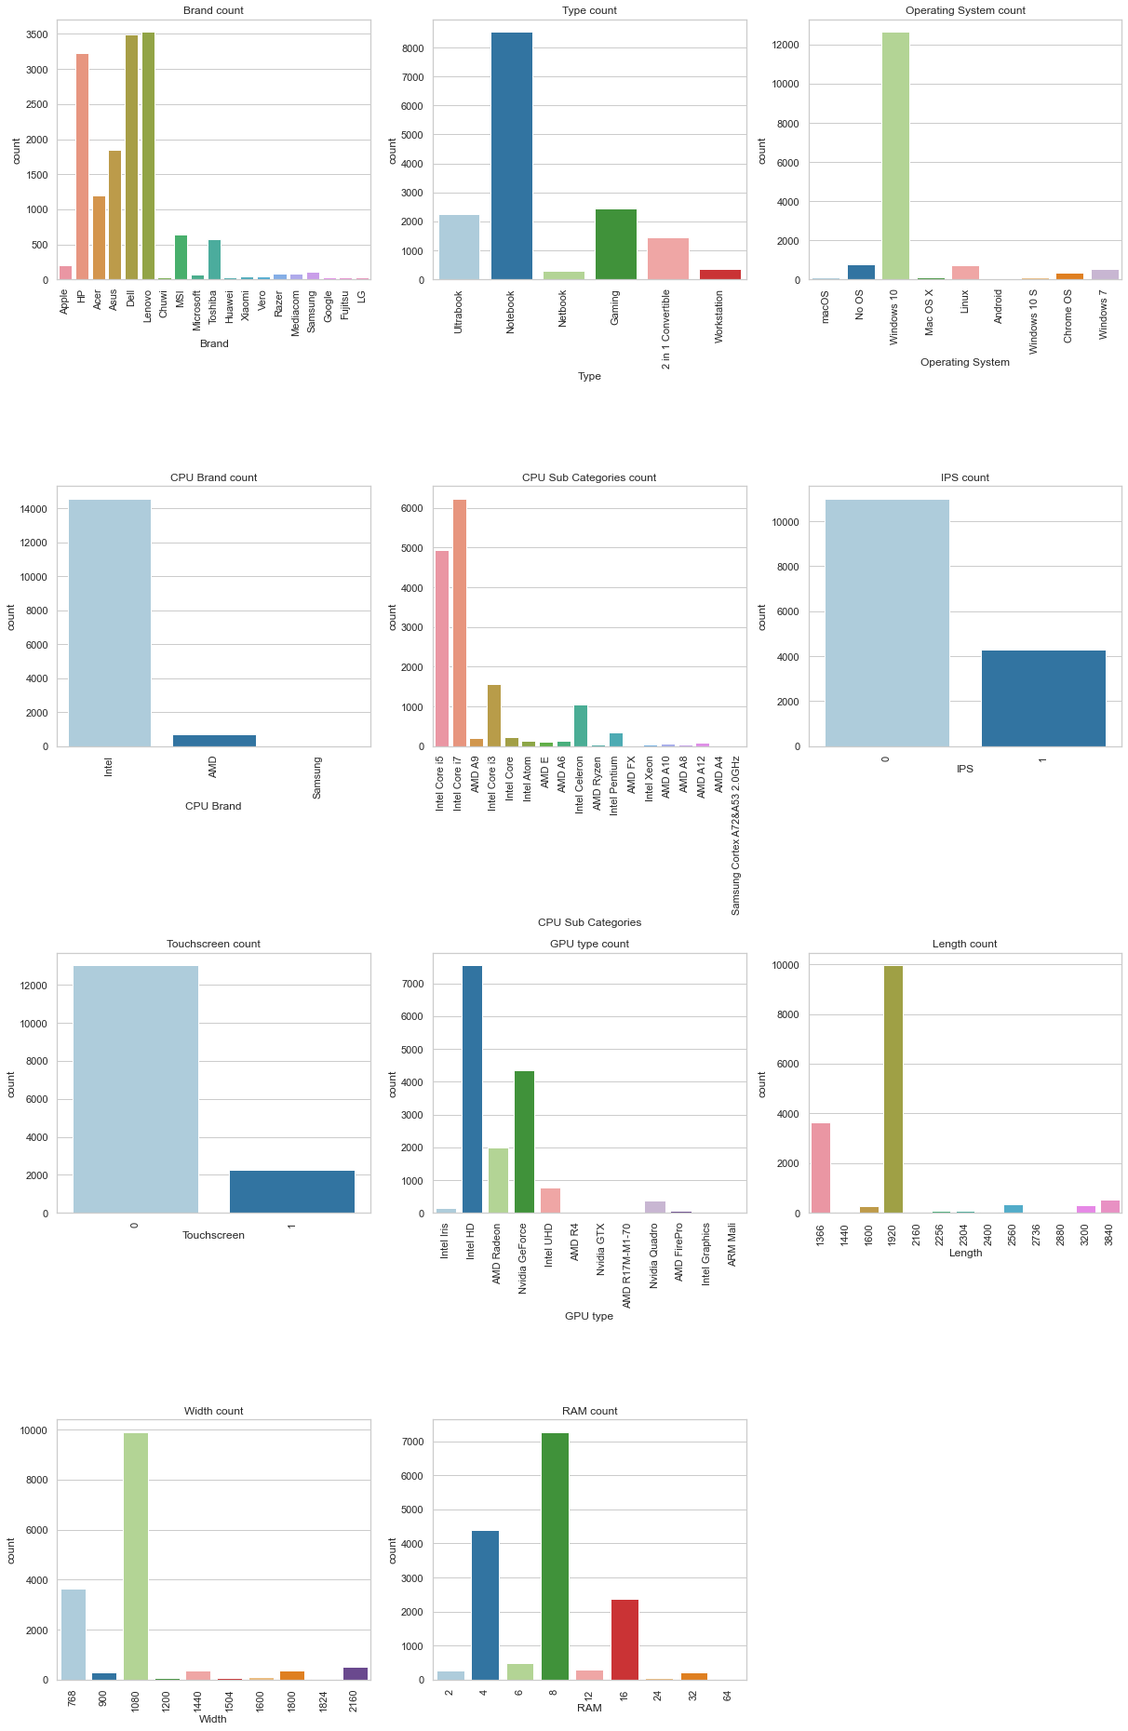
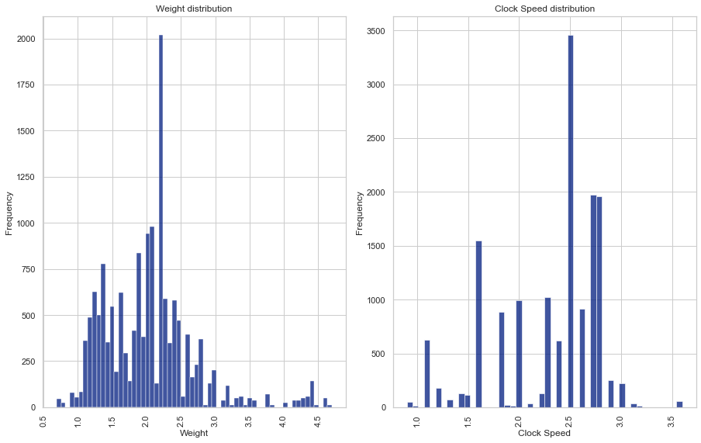
EDA
Histogram
Most common for each feature is:
Weight of around 2.4KG
2.5GHz
-Brand : HP , Asus , Dell , Lenovo
Type : Notebook
OS : Windows 10 (other OS a lot more rare)
CPU Brand : Intel (Other brands more rare)
CPU Subtype : i5 and i7
Screen : 1920 x 1080 no IPS and no Touchscreen
GPU type : Intel HD and Nvidia Ge Force
RAM : 8GB
These specs above are very common.
The model should perform well on these common specs but might struggle for computers with higher specs (as they are rarer) .

Slide 10
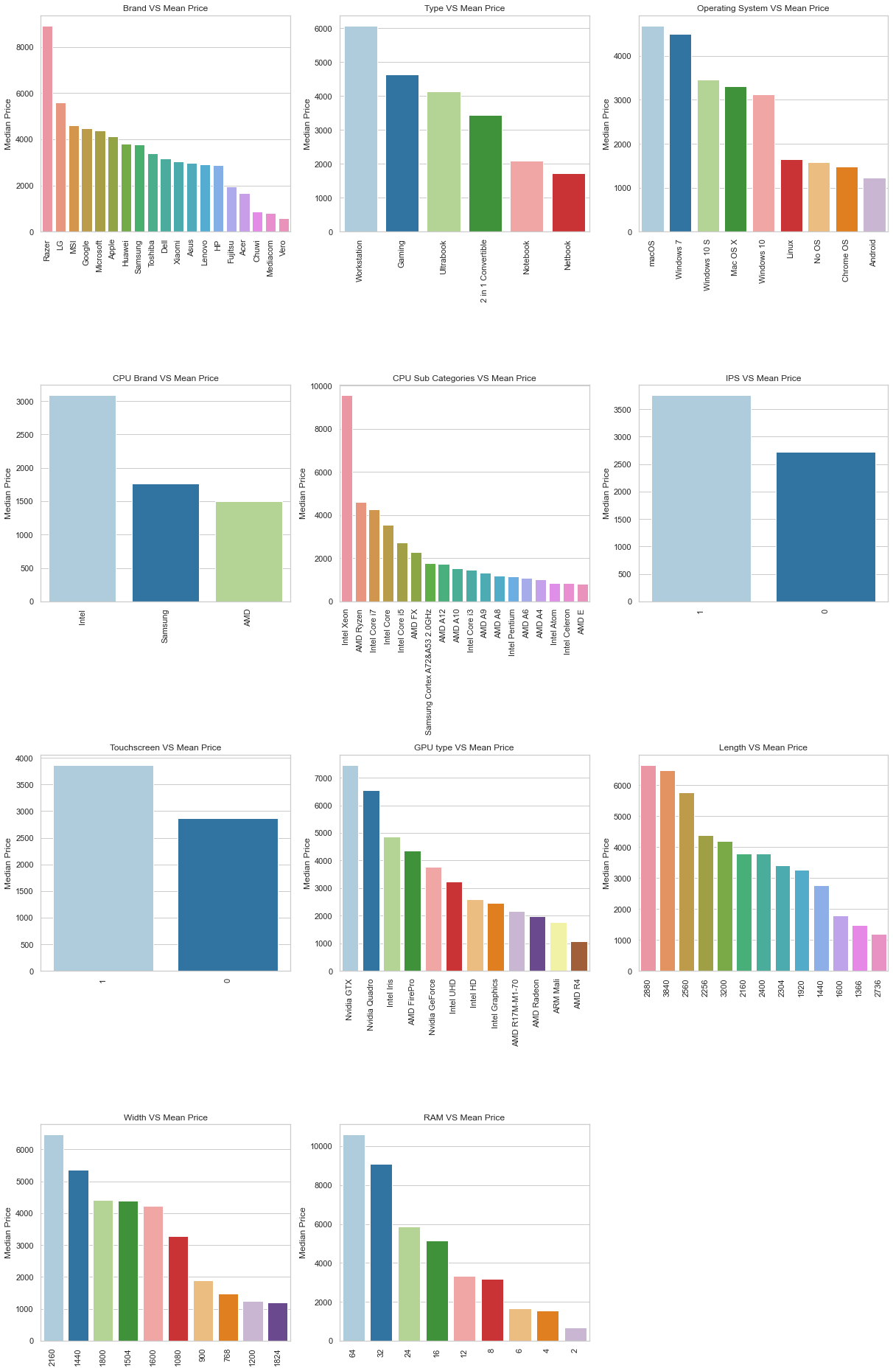
EDA
Brand
Razor pc significantly more expensive than the rest as they sell gaming hardware with higher specs
Chuwi ,Mediacom , and Vero least expensive less well known in the market
OS
mac OS computers are the most expensive due to the 'Apple Tax'
No OS computers are more expensive than Chrome OS /Android. Due to No OS computers have significantly more advanced hardware than Chromebooks and Android based PC
CPU Brand
Intel significantly more expensive than AMD and Samsung as Intel is the market leader
CPU Subcategories
Xeon CPU is significantly more expensive as they typically have more cores
Lower end models like Intel Atom and Celeron computers are less expensive
Screen
Screens with IPS and Touchscreen significantly more expensive as the panel more expensive to make

Slide 11
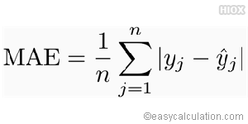
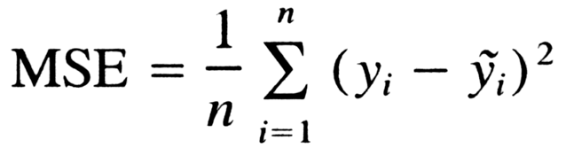
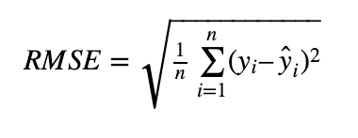
Modelling – Choosing a Metric
- MSE and MAE are 2 methods to find the average error made by the regressor per data point
- Using squaring or absolute value, they make the residual positive, regardless of whether the predicted value of y is above or below the actual value of y
- Squaring penalises large error as sqauring larger errors makes the error even larger
- Hence, using MSE can prevent large errors
- However, MAE is easier to intepret as the numbers are smaller
Square root of MSE (Which is RMSE) is used as final metric as it penalise large error and easier to intepret (as numbers are smaller after square root)

Slide 12
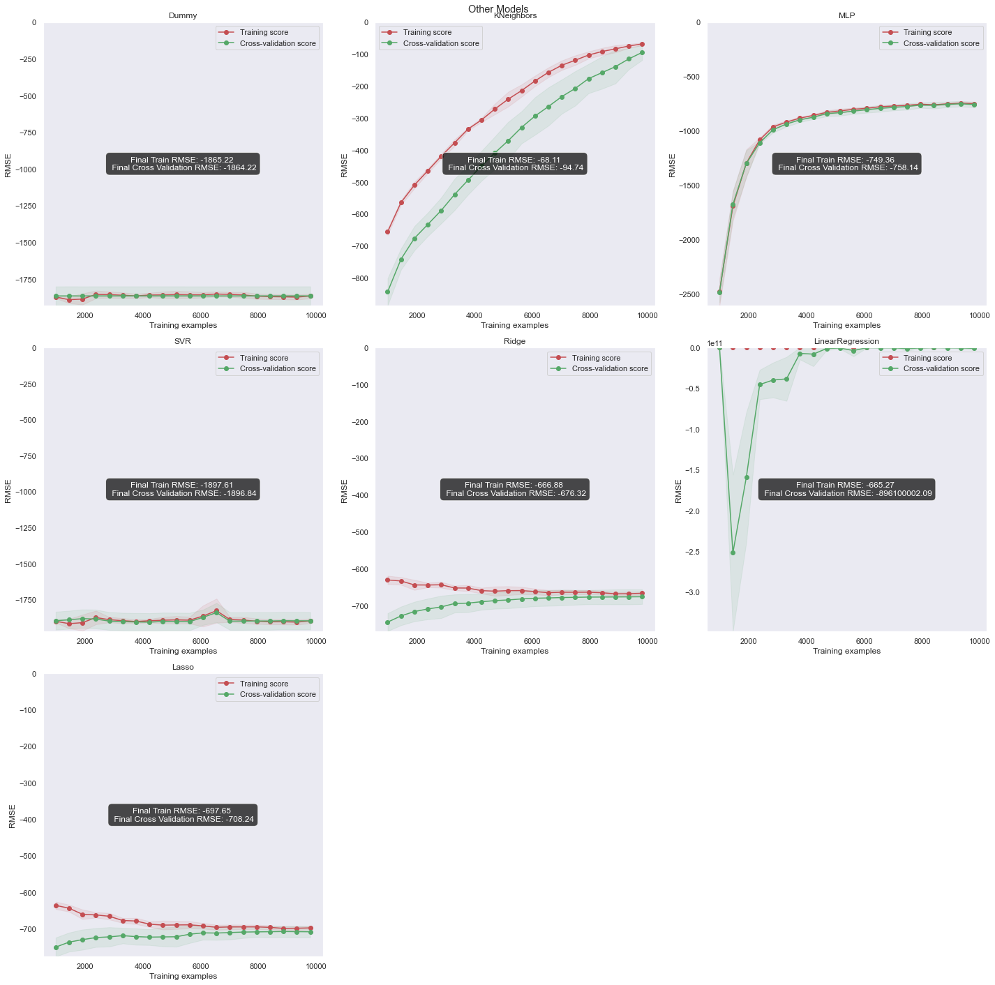
Modelling – Model Choosing (Non Ensemble)
- DummyRegressor Predicts based on the mean of the dataset, as the distribution of price is non gaussian, but right skwed, it leads to large errors and a large RMSE
- LinearRegression , Lasso , Ridge and SVR underfitting,as they are unable to capture the non linear relationship between the features and price
- Neural Network moderately underfits , as we do not have enough datapoints for it to perform well. It’s curve is very steep at the start but plateau out soon at 3000 training examples. It might be due to the max iters 200 of neural network. However, Increasing it would lead to long training times.
Kneighbours Regressor actually performs quite well (compared to the rest here) (expected as different computers with similar specifications have similar prices) , but slightly overfitting

Slide 13
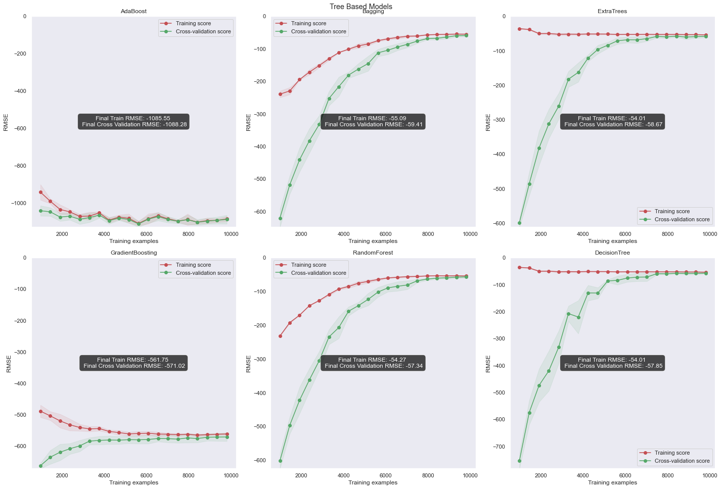
Modelling – Model Choosing (Ensemble)
-Adaboost and Gradient Boosting underfitting
Bagging , ExtraTrees , RandomForest ,DecisionTree perform similarly with both low Test RMSE and Train RMSE
Decision Tree is chosen as it trains only one tree (simpler) unlike Bagging , ExtraTrees , and RandomForest

Slide 14
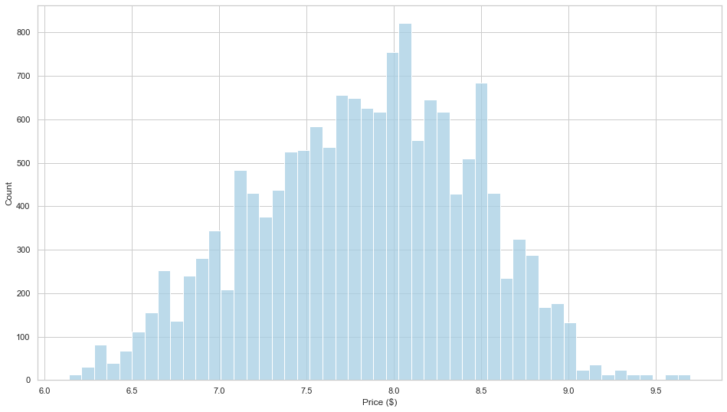
Modelling – Improvement
Using log transform with Transformed Target Regressor might help to improve the model, as it makes the prices more normally distributed.
Thus making it easier for the model to predict
Before Log transform
After Log transform

Slide 15
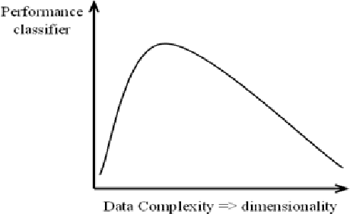
Modelling – Curse of High Dimensionality
There are 177 Dimensions after one hot encoding. Which may lead to Curse of High Dimensionality
There is high dimensionality in the data after one hot encoding so many categorial features ['Brand', 'Type' , 'GPU' , "Operating System" , 'CPU Brand' , 'CPU Sub Categories']
According to huges rule, predictive power of model decreases if too many features are added to it
It can be solved using PCA or RFE
RFE Removes the features based on their feature importance on the decision tree (least important features are removed)
PCA creates new features which are linear combinations of old features while minimizes the amount of variance lost

Slide 16
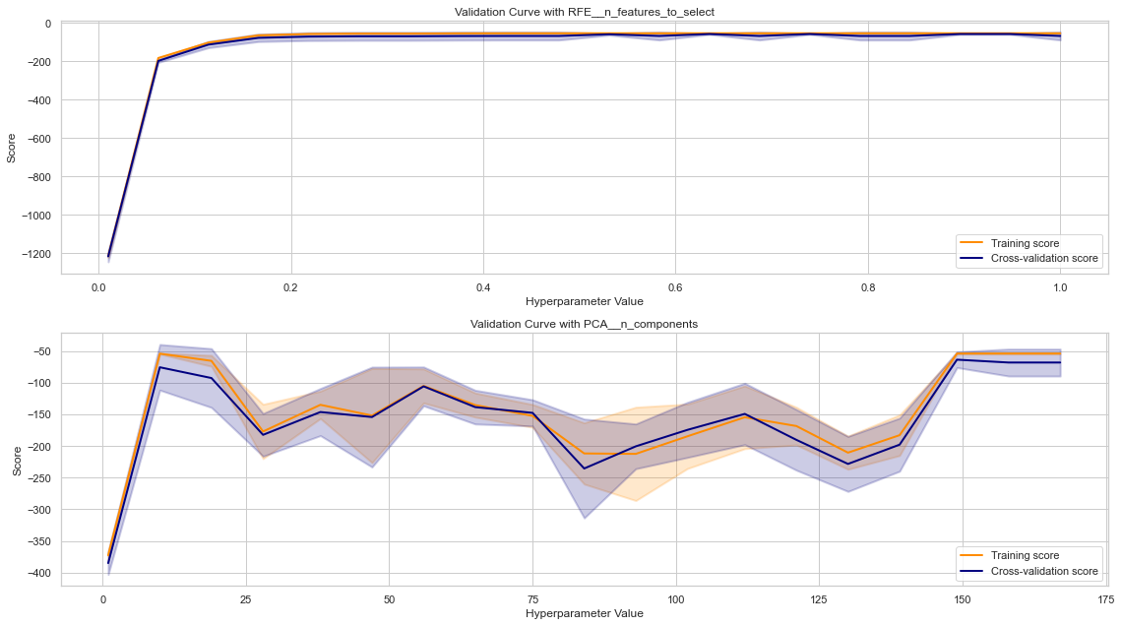
Modelling – Curse of High Dimensionality
PCA
PCA has larger Standard Deviation (larger spread in scores between each fold of 5 fold cross validation ) in both train and test scores
PCA also has no clear trend between n_components kept and RMSE
It is preferred as its results are less stable
RFE
Curve Plateau out at around 0.2
Most of the features are redundant as most of the graph is flat
By removing these features, it is easier for the decision tree to split a node (as it does not have to choose features from so many columns), which may lead to the decision tree to train faster

Slide 17
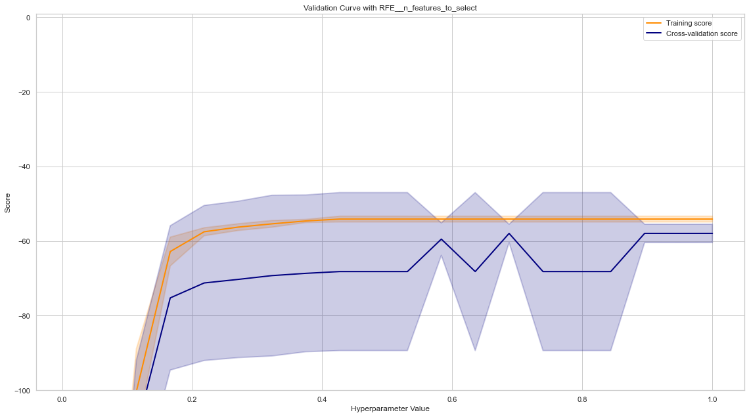
Modelling – Curse of High Dimensionality
Graph looks to plateau out completely at 0.4, Hence, 40% of the features are kept

Slide 18
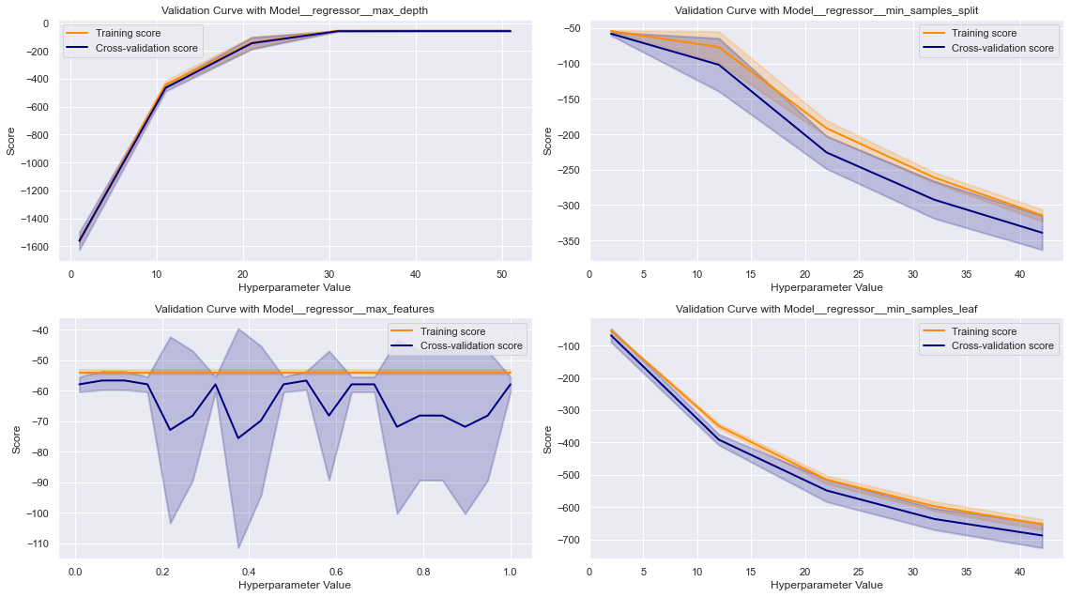
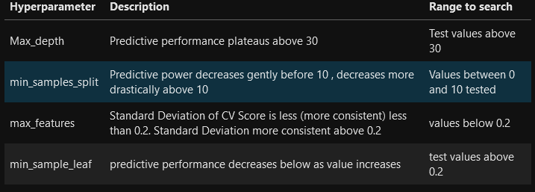
Modelling – Validation curve
Summary of Validation Curves
- Validation Curves monitor how the model performance changes with different hyperparameter values
- Allow us to know the approximate ranges to test for GridSearchCV
- Max Depth prevents the tree from growing too big which causes overfitting
- min sample split is the minimum amount of samples required at a tree node to split it (larger values make model more regularized)
- min sample leaf is the minimum amount of samples for node to considered leave (larger values make model more regularized)
Also allow us to save time on grid searchcv (as more specific ranges are tested for hyperparameter tuning after validation curve)

Slide 19
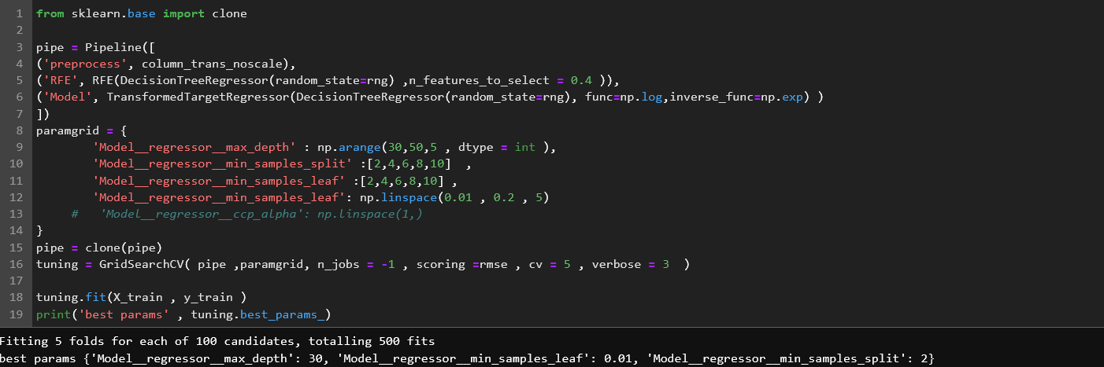
Modelling – Hyperparameter Tuning
Hyperparameter tuning with these ranges shown.
Obtained Hyperparameters that should improve the bias variance trade off.

Slide 20
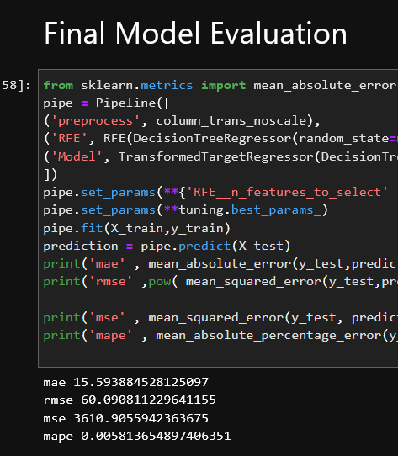
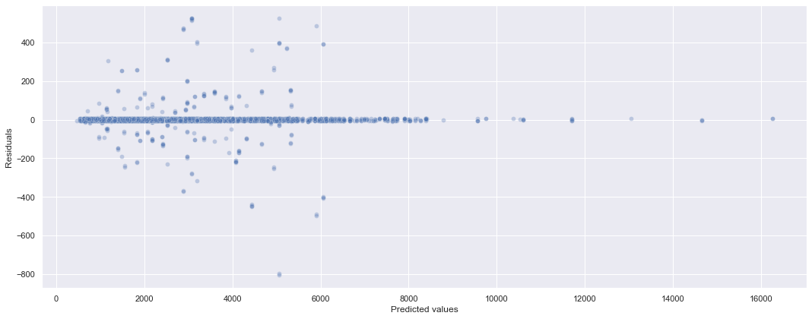
Final Model Evaluation
- We have predicted a model that achieves a final rmse of 50 and mae of 15
- Suspect that there are some large errors predicted on the test set due to the difference between the rmse and mae
- There are some large errors made by the regressor despite the low mean average percentage error of 0.005

Slide 21
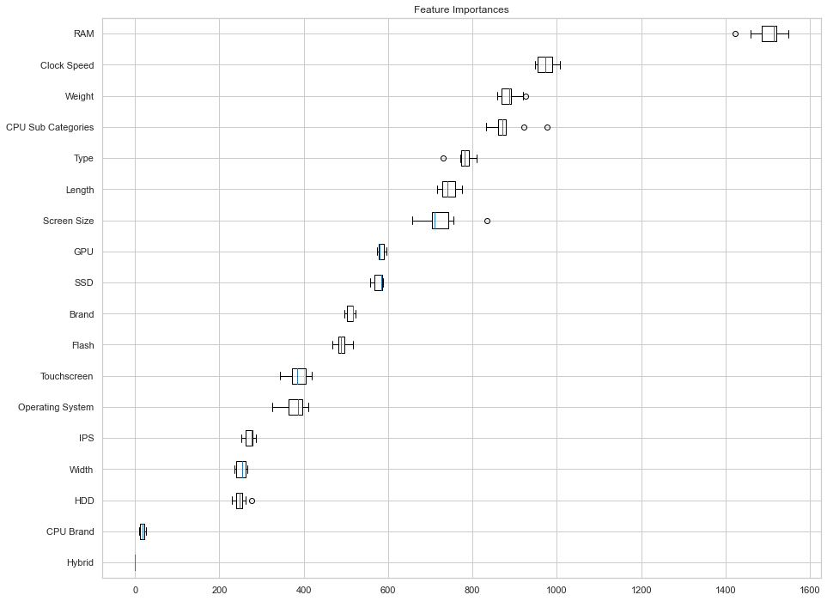
Feature Importance
- Ram is significantly more important than the rest of the features
- Most of the features that are important impact the user experience the most (RAM and clock speed affects computer speed ) , (weight affects portability) , (screen size , affects the viewing experience )
- Clock speed has weak correlation with price, but is the second most important feature, showing that the relationship between clock speed and price is nonlinear
Conclusion
- We have successfully created a model that predicts pc prices accurately generally ,as the mean abosolute percentage error is 0.005%.
- However, there are some large errors being made by the model which might be due to a lack of information such as the year the computer is released.

